Slide 1
Event driven development
Alexey khazov
Game engineering bachelor
CMGT master’s student
www.Khazovalex.com
Master class Unity and C#

Slide 2
structure
Interactive workshop
Follow along
Write code in real time

Slide 3
topics
Composition
Single responsibility principle
Communication methods between components
Different types of events

Slide 4
project
Simple character movement with effects
ui
Data
sound
Particles
Write and modify code live
Presentation project Github: https://github.com/123099/Event-Driven-Development

Slide 5
Common setup
Player class
Update method
Handle input using horizontal and vertical axes

Slide 6
Common setup extended
Requirements
Add footstep sounds
Add footstep particle effect
Add health
Add ability to attack (damages itself for simplicity’s sake)
Display health ui
Display damage ui
Animated damage numbers spawning, moving up, and disappearing

Slide 8
Common setup extended
volunteers?
Requirements
Add footstep sounds
Add footstep particle effect
Add health
Add ability to attack (damages itself for simplicity’s sake)
Display health ui
Display damage ui
Animated damage numbers spawning, moving up, and disappearing

Slide 9
It works?
advantages
problems
Notes:
Fill a table with the 2 columns on a white board together with the students

Slide 10
Clean up
We have a player component, but it’s acting as a god object.
It has different functions related to a player, but composition is lost.

Slide 11
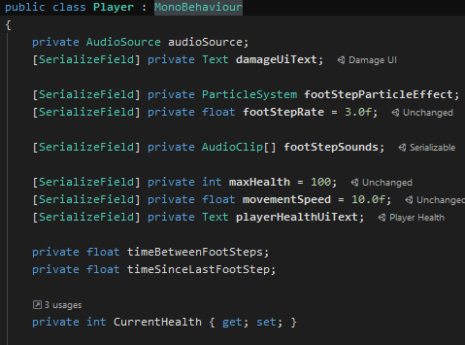
Clean up - ui
Let’s start with the UI.
It is related to the player, but…
Can the player exist without it or not?

Slide 12
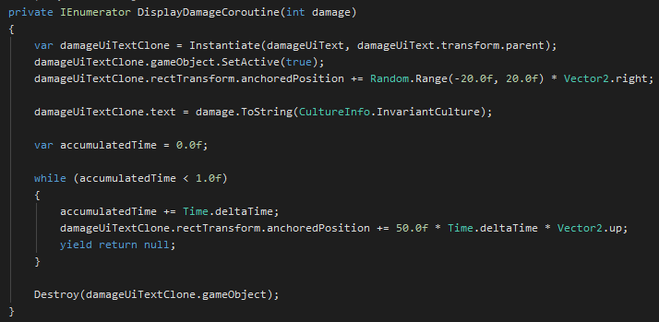
Clean up - ui
UI Logic and animations handled in player
Hard to find in codebase
Hard to reuse code
Cannot test player logic without ui

Slide 13
Clean up - ui
Damage ui
Health ui
Separate components
get information from the player
Volunteers?

Slide 14
Clean up - ui
Player no longer depends on ui
Ui relies on data from the player and gets it through a reference
Has to poll for data every frame
Player has to manage different variables for other components to use

Slide 15
Clean up – ui - Polling
Has to poll for data every frame
Frequent unnecessary updates that affect performance

Slide 16
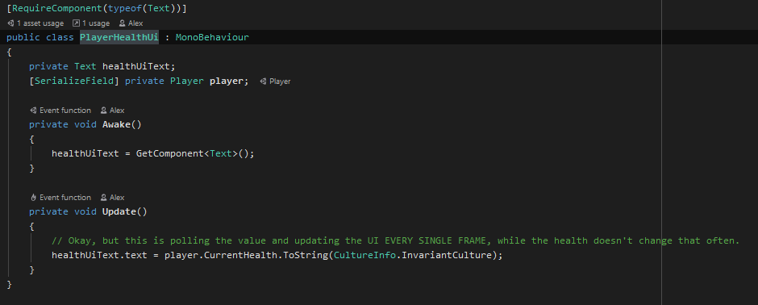
Clean up – ui - Polling

Slide 17
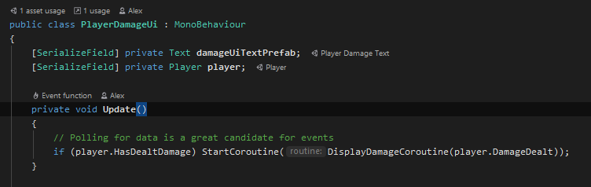
Clean up – ui - Polling

Slide 18
Clean up - ui - polling
Polling for data is a great candidate for events

Slide 19
Clean up - ui - events
Perform logic on demand
Easier communication between components
Built in C#

Slide 20
Clean up - ui - events
Perform logic on demand
Easier communication between components
Built in C#

Slide 21
Clean up - ui - events
events are delegates with a few restrictions
delegates are references to methods with a particular parameter list and return type
Calling / executing / invoking an event calls all the methods subscribed to that event
Only the type defining the event can invoke it

Slide 22
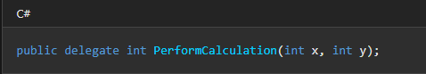
Clean up - ui - events
delegates are references to methods with a particular parameter list and return type
Return type
Parameters
Name
Keyword

Slide 23
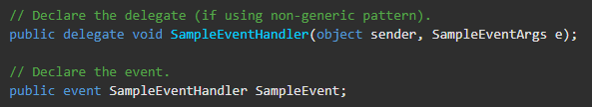
Clean up - ui - events
events are delegates with a few restrictions
Event Name
Keyword
Delegate Type

Slide 24

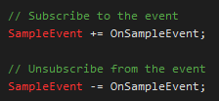
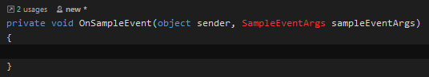
Clean up - ui - events
Only the type defining the event can call it

Slide 25
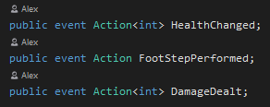
Clean up - ui - events
Built-In most used delegates
Action
Action<T…>

Slide 26
Clean up – ui - Events
Player no longer depends on ui
… but it still handles a lot of other logic
sounds
Particles
… And ui still polls data every frame
composition & Events

Slide 27
Clean up – Composition & Events
Replace polling for events
Extract sound and particle effects into separate components
Volunteers?

Slide 28
Clean up – Composition & Events
Advantages
problems

Slide 29
Clean up – further composition
Player does 3 things
Movement
Footsteps loop
Attacking
These functions are not specific to a player
Each of these could be a reusable component

Slide 30
Clean up – further composition
Every component represents a possible behaviour
Player class is a container that hooks up behaviours together
Reusable components
Events help connect and communicate between components without direct dependencies

Slide 31
Other types of events
Built in C# events and delegates
Unity event systems
Sendmessage
Unityevent
Unity event system*
Scriptable objects
Custom event system
*Outside the scope of this master class

Slide 32

sendmessage
Advantages
problems

Slide 33
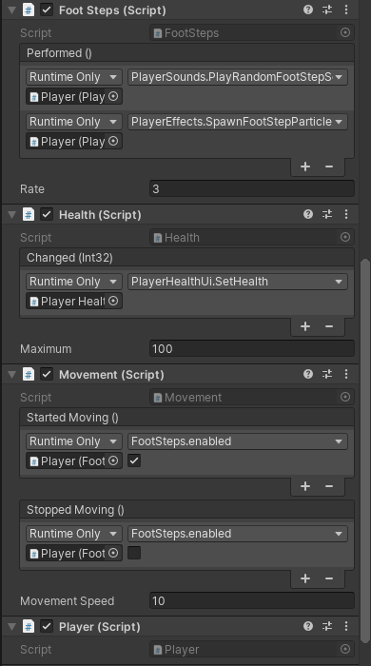
unityevent
Very similar to C# events
Can be serialized and set up in editor using drag and drop
Boiler-plate code when requiring parameters
Can be invoked by anyone at any time

Slide 34
Unityevent
Code example

Slide 35
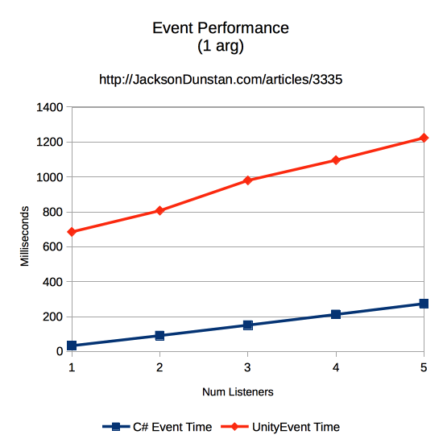
Unityevent - performance
Much slower than C#
… but easier to use, especially for designers
… and the less code needed to change later in development means less risk
Great for events that don’t happen too frequently

Slide 36
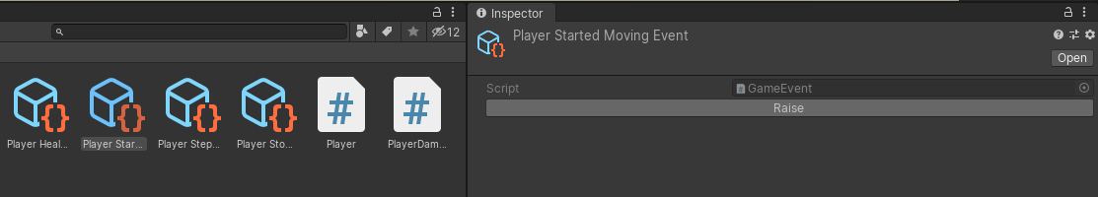
Scriptable object events
Create, send, and react to events without any code
Incredibly designer friendly
Low risk later in development
Example code available on github

Slide 37

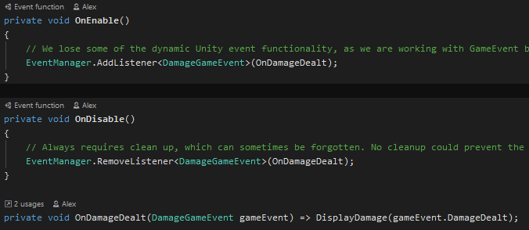
CUSTOM EVENT SYSTEM
BASED ON c# EVENTS
MORE CONTROL
GLOBAL EVENT MANAGER
REMOVES THE NEED TO HAVE REFERENCES TO OBJECTS WHOSE EVENTS WE WANT TO LISTEN TO
Example code available on github

Slide 38
Thank you!

Slide 39
Questions?
Event driven development in unity
Alexey Khazov
www.Khazovalex.com
Github project: https://github.com/123099/Event-Driven-Development

